Slide 1

Web Security Basics
Dr. Muhammad Umar Aftab

Slide 2

Outline
Web technologies
  Web Browser
  Web Server
  HTTP Request
Cookies and sessions
Ajax, WebSocket and same-origin policy

Slide 3
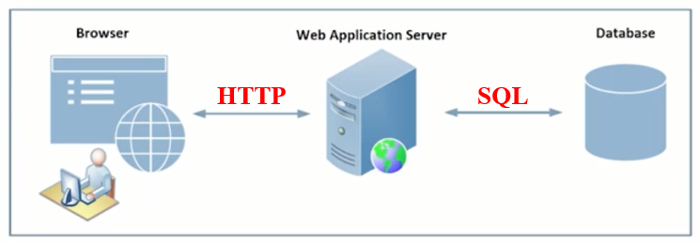
The Web Architecture
The web Architecture have three following components:
  Browser
  Web Application Server
  Database
Notes:
Browser is at client side.
Server and browser communicate through HTTP protocol. HTTPs for encrypted communication.
If server has some data for store/access then it will use SQL.

Slide 4
Web Browser
Notes:
Lab Setup: https://seedsecuritylabs.org/labsetup.html

Slide 5
HTML
We are not going to discuss all the technologies except the few one.
Like we just discuss or recall previous concepts.
Like basic data part → Then Presentation part (CSS)

Slide 6
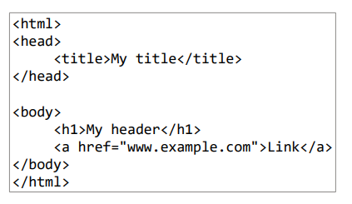
HTML
Notes:
If its encrypted then it will use HTTPs

Slide 7
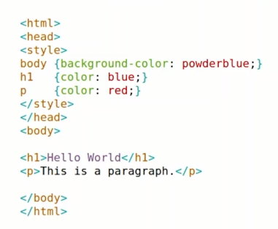
CSS: Cascading Style Sheet
It will tell the browser : how to render and deal with this content.
Notes:
Presentation of the data (CSS), → Which color, style

Slide 8
Plug-ins
Browsers have limited functionalities, but people wants to do additional work → So plug-ins help to do that
The browser plug-ins are a binary piece of code that manages Internet content that a browser is not designed to process.
For example, you wanted to open a pdf file on website, you may need Adobe Acrobat Reader plugin to do so. If the plugin is not installed, your browser will not understand how to open pdf.
The plug-in lie inside protected gate of browser. The plugins are just like part of browser, so they can access to memory.
Notes:
Plug-ins are in the form of libraries. When you invoke the plug-in → you are basically invoking those libraries.

Slide 9
Vulnerability of Plug-ins
Vulnerability:
  The plug-ins can one of the vulnerability source, because plug-ins are developed by 3rd parties so it might be from attacker-side. The attacker can embed malicious code inside plug-ins and plug-ins can access to memory directly.
Solution:
  The browser developer are trying to add maximum functionality in the browser. So, the need of plug-ins are gradually decreasing. For example, there is no need to install Adobe Acrobat Reader plug-in. Because HTML5 in browser support to open pdf file.

Slide 10
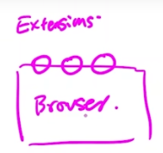
Extension
Browser extension is a small software application that adds a capacity or functionality to a web browser its own set of APIs. They can also be used to remove unwanted website elements such as pop-up ads and features such as auto-play for online videos.
The browser extensions are written in high level language i.e., scripts.
Extensions talk to the data and resources through APIs, in the browsers.
They don’t have direct access to memory because they are outside the gate.
  There are a lot of access control involve in this way.
Plugins are inside the gate so they have direct access to resources of system.

Slide 11
Extension
Examples of browser extensions:
  AdBlock: enables content filtering and ad blocking.
  StayFocusd: limits the amount of time the user is allowed to spend on designated websites.
  Highly: allows the user to highlight webpage text and share it through social media, email.
The extensions lie outside protected gate of browser. So, they can not access to memory.

Slide 12
Dynamic Content
Dynamic content a web-page or email component that changes based on the user signals i.e., behavior, preferences, and interests of the user. The source of dynamic content are in-session behavior, user data, and user-characteristics.
  In-session behavior: Adapt content based on what pages they visit, which products they add to cart, and how long they spend on site.
  User data: Change content based on past purchases, customer lifecycle, or past engagements.
  User Characteristics: geo-location or buyer personas.

Slide 13
Technologies to Create Dynamic Content
Adobe Flash (animation)
Microsoft Silverlight
ActiveX
Java applets
JavaScript
  These days, most popular is java script for creating dynamic content

Slide 14
JavaScript and Sandbox

Slide 15
JavaScript
JavaScript is a scripting language that enables you to create dynamically updating content, control multimedia, animate images and also implement complex features on web pages.
JavaScript can calculate, manipulate and validate data.
Suppose you download a file and execute it → Leads to risks
But on the web we do that on daily basis, we invite codes to come and execute on our computers

Slide 16
JavaScript
How JavaScript Makes Things Dynamic:
  HTML defines the structure of your web document and the content therein. CSS declares various styles for the contents provided on the web document.
  HTML and CSS are often called markup languages rather than programming languages, because they, at their core, provide markups for documents with very little dynamism.
  JavaScript, on the other hand, is a dynamic programming language that supports Math calculations, allows you to dynamically add HTML contents to the DOM, fetches contents from another website, and lots more.
Notes:
Document Object Model (DOM)

Slide 17
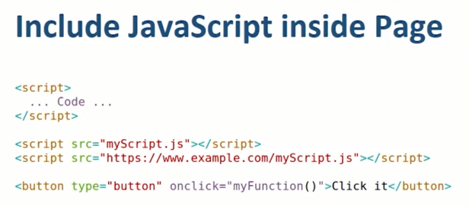
Include JavaScript Inside Page
Notes:
You can integrate the code by event of button click

Slide 18
JavaScript Engine
The javaScript engines are used to compile javaScript byte code.
Java script engine is inside your browser. Also, you can consider the engine as JavaScript VM.
The javaScript engines also enforce security polices, So sandbox run inside the javaScript engine.
Different web browser have different javascript engine:
  V8 from Google (for Chrome and Microsoft Edge)
  SpiderMonkey from Mozilla (for Firefox)
  JavaScriptCore from Apple (for Safari)
All Engines run bytecode and enforce security

Slide 19
Security Consideration
Question: why can't we just use binary code?
<binary src=“https://www.example.com/code.bin”></binary>
  It is very difficult to enforce security on binary because binary run-on top of CPU
  So it talk/ deal directly with CPU → OS can handle on that stage
  But OS doesn’t know which binary related to browser and which related to untrusted code.→ OS doesn’t have such granularity to separate them.
Byte Code
Engine
OS
CPU
Notes:
The bytecode is a format that simplifies the execution of the JavaScript code by an interpreter, and then by the Just-In-Time compilers (JITs). The bytecode is much larger than the source code, so Firefox only generates the bytecode of executed functions.

Slide 20
Security Consideration
So you have this layer (Engine layer)→ This layer is part of browser
Any bytecode will come→ browser knows about it that it is coming from a trusted party or untrusted party etc.
In this way, we can apply access control on the behavior of byte codes.
Byte Code
Engine
OS
CPU

Slide 21
Sandboxing JavaScript
Sandboxing is a security mechanism that allow you to run piece of code in isolated space.
Benefits:
  Helpful for executing untrusted applications
  Prevent the system from permanent changings
  Secure web browsing: a malware downloaded from website can not harm to your system
Example:
  The most popular tools is sandboxie.

Slide 22
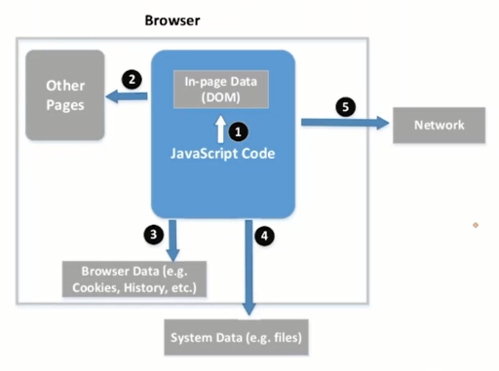
Behavior of Sandbox
The sandbox decided that what kind of things can be accessed. As shown in following figure that 1, 2 , 3, 4 and 5 are assessable to sandbox.
Notes:
We are not going to discuss network part right now

Slide 23
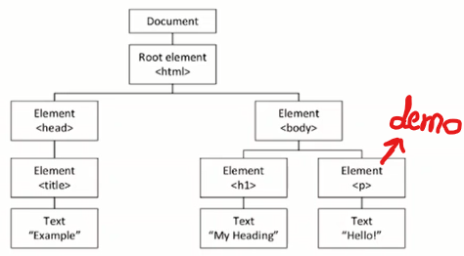
Accessing Page Content (1/2)
HTML DOM (Document Object Model)
  Every element is a node. You can access with the list of APIs provided by the browser. → every element has id
Document.getElemmentById(“demo”).innerHTML=“Hello World”

Slide 24
Accessing Page Content (2/2)
Once you find the reference of element through API, then you can change the content of same page. But you can’t modify to another page, you have not reference of another page.
These things get complicated when developer use iframes inside a side web page, because each iframe behave as web page inside a web page.
HTML Objects (examples)
  document.cookies
  document.images
  document.forms
  document.URL

Slide 25
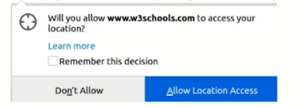
Accessing Browser Data
The Browser Object Model (BOM)
  The window object
  The browsing data belongs to user. The server and 3rd parties can access user browsing data through APIs with user permission.
Objects (examples)
  window.history
    back() and forward() APIs
  window.navigator
    navigator.geolocation.getCurrentPosition()

Slide 26
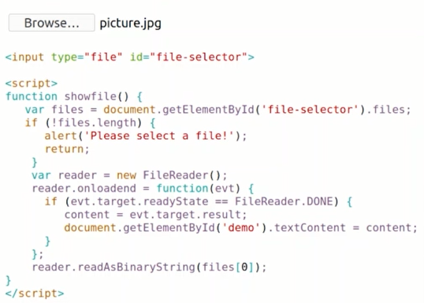
How JavaScript Access to Files
There is no API who can access the file directly from memory.
The file is open in the browser when user browse the file to upload. Then the reference of file from browser is given to javaScript Code.
This is beauty of Access Control.

Slide 27
Web Server

Slide 28
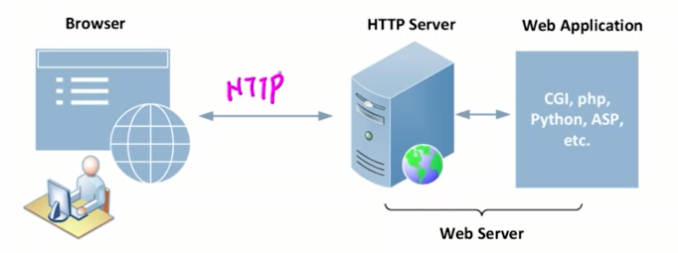
Web Server
The HTTP server only respond to static content. So, Web Application Server are used to respond dynamic content.
Th HTTP server communicate with web application server using CGI (Common Gateway Interface), Fast CGI or Modules (apache)

Slide 29

Server-Side Script
Mostly server provide dynamic content. They also create dynamic pages. The technologies used to create dynamic content are php, python and javaScript etc.
Return Data
The apache server knows the php tags and it will replace response against “.date(“h:i:sa”)”

Slide 30
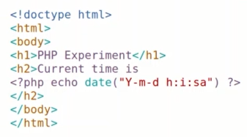
Server-Side Script
Return Data on HTML page: Inline
Notes:
Inline elements are those which only occupy the space bounded by the tags defining the element, instead of breaking the flow of the content.

Slide 31
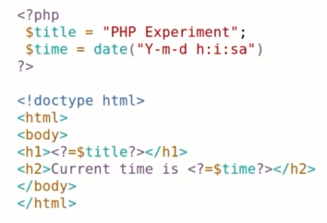
Server Side Script
Return Data on HTML page: Use Template (Use for Large number of files).

Slide 32
How Client Interact with Server
The javaScript is runing on browser side and scripts are used at server side. How server and browser interact with each other?
There are three ways as follows:
  HTTP Request
  Ajax Request
  WebSocket

Slide 33
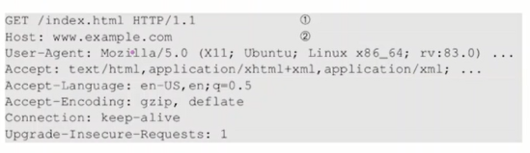
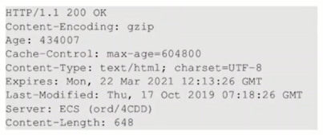
HTTP Request and Response
HTTP Request
HTTP Response

Slide 34
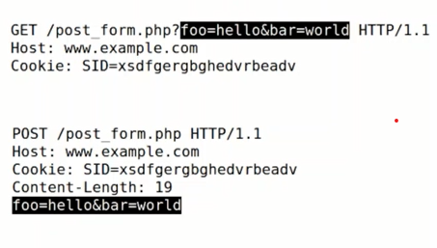
GET and POST Methods
Notes:
The GET and POST method are used for sending the data to the server.
The main difference between them is that GET method append the data to the URI defined in the form's action attribute.
Conversely, POST method attaches data to the requested body.

Slide 35
Cookies and Sessions

Slide 36
Stateless Nature of Web
Suppose a user send http request to server, the server process the request and respond to user. But, server did not keep the record of user.
2nd time, when same user send http request to server. The server can not recognize the user, that this user visited the site before or not.
So, this is problem

Slide 37
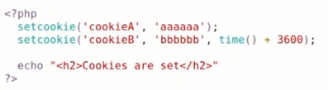
Cookies (1/3)
Cookies are designed to keep track record of user at user end.
Suppose a user send http request to server, the server process the request and respond to user with cookies. The cookies are saved on browser.
2nd time, when same user send http request to server. The cookies will attach with request automatically. The server will recognize the user and treat him in a better way.
PHP code example:

Slide 38
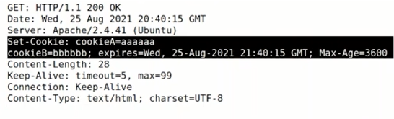
Cookies (2/3)
Setting cookies in HTTP response

Slide 39
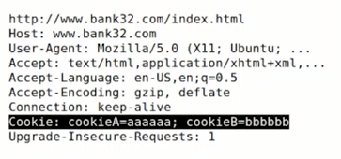
Cookies (3/3)
Attaching cookies in HTTP request

Slide 40
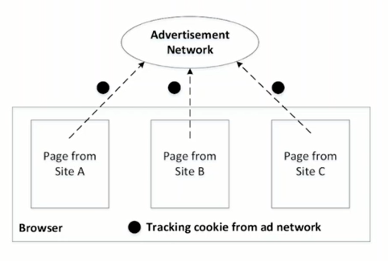
Web Tracking Using 3rd-Party Cookies

Slide 41
Session and Session Cookie
The cookies are stored in browser of user. But every data of user can not store on user side. Suppose a shopping website store all user data at user side in form of cookies i.e., quantity, price, size etc. The user’s bill is created 1000$ that is also saved in form of cookie at user end. The user can change the price. So, this is vulnerability.
The solution is that price must be saved on server. But problem is that how server will recognize that which price is belong to which user. So, Session Id is used for this problem.
The Session ID is a cookie that is assign to user on the time of login. The session ID expired as user logout.
The session ID must be secure. If attacker can steal session ID using sniffing attack, then he/she don’t need to steal username or password to login into user account.

Slide 42
Ajax & Its Security Policy

Slide 43
Ajax versus Normal HTTP Requests
In the normal http request, the request send to http server from web page. The server process the request and respond to browser. When response come from server then previous page on browser will be discarded (where from the http request sent). And the new page will be displayed/loaded on browser (this new page is response of server).
But In the Ajax request, the request send to http server from web page. The server process the request and respond to browser. When response come from server then previous page (where from the http request sent) is updated according to server response.

Slide 44
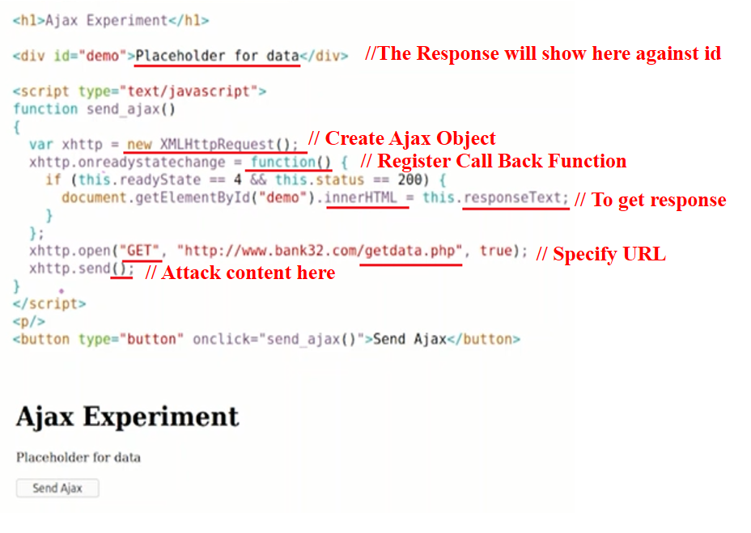
How to write Ajax Code
Notes:
Attach content here

Slide 45
How to write Ajax Code
You need http object to send request
Ajax is a asynchronous. Its means that when user send request to server, then current page don’t block. Even user can use other feature of page.
As server response comeback, then browser will notify you if you have register call back function. User get server response in the call back function.

Slide 46
Origin Policy on Ajax
HTTP Case
  Suppose you have active session of facebook.com. You are also using google.com. You send a request from google.com to facebook.com. The server of facebook.com will respond. The response will show you on facebook.com instead of google.com. Because http discard the page that send request to server and show response page on new window. This case has no vulnerability.
Ajax Case
  Suppose you have active session of facebook.com. You are also using google.com. You send a request from google.com to facebook.com. The server of facebook.com will respond. The response will show you on google.com. Because ajax update same page. This case has vulnerability, because the data of some website is showing on another website.

Slide 47
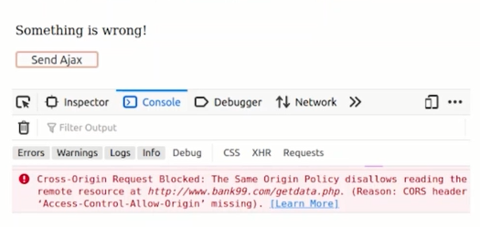
Ajax Security Policy
In the ajax security policy, the browser will block to cross origion response.
Suppose the request is send from google.com to facebook.com. The server of facebook.com will respose the request. But, browser will block the response.
If facebook.com add permission to display data on other site in response header, then browser will release the response.

Slide 48
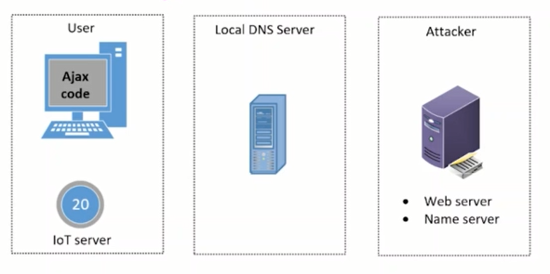
Bypassing Same-Origin Policy via DNS Rebinding
Notes:
DNS rebinding is a cyberattack where a malicious website tricks a victim's browser into treating a domain's IP address as if it belongs to the user's local network. Attackers use their malicious domain's DNS server to repeatedly change the IP address it resolves to, first to a public IP and then to a private, internal IP address. This bypasses the Same-Origin Policy, allowing malicious scripts to access internal devices and sensitive data within the user's network, such as IoT devices or web-based consoles.

Slide 49
Websocket
The websocket is also used to communicate the browser with server. But the problem in http and ajax is that user has to establish connection again and again to get updated with the data from server.
But in the websocket, one connection is established. The server automatically send updated data to client.

Slide 50


